Slide 1
ECEN 5593
Performance of branch prediction on SweRV EH1 core
Submitted by:
Pranav Bharadwaj, Malcolm McKellips

Slide 2
CONTENTS
Aim of the project
RISC V and SweRV EH1 core
Branch prediction flavors
Evolution of Design
Implementation
Results
Challenges
Conclusions
Demo

Slide 3
AIM
To synthesize a RISC-V processor (SweRVolf EH1) on an FPGA and compare the performance of the core with branch prediction enabled and disabled.
To use PlatformIO, an open-source IDE for debugging assembly on the core using OpenOCD and gdb.

Slide 4
RISC V and SweRV EH1 core
RISC V is an open ISA representing the 5th generation of RISC designs. Developed at University of California, Berkeley.
The reference base RISC-V ISA is open to interpretation and change.
SweRV core is RISC-V core developed by Western Digital. This is a commercial product with RTL available for synthesis.
The base reference RISC-V architecture used is the RV32IMC (supports integer, dedicated multipliers and dividers and compressed instructions)
EH1 core is available in machine mode (M-mode) only. Thus, one has complete access to all hardware features but no virtual-memory and MMU support.
This requires the core to be synthesized to observe its operation using an IDE

Slide 5
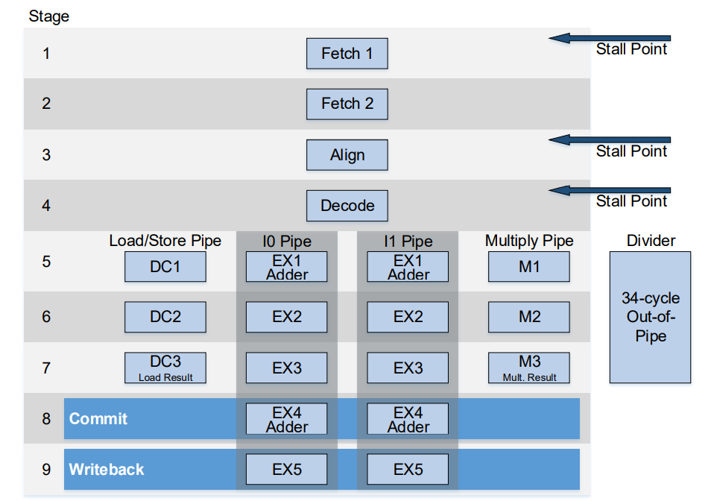
SweRV EH1 continued
The processor is 32-bit, 2-way superscalar with a 9-stage pipeline design.
The branch prediction implemented onboard is the GSHARE prediction model.
This guarantees a probability higher than 50% for total number of correct predictions.

Slide 6
Branch Prediction Flavors
Static branch prediction - 50%
Saturating branch prediction (one and two level) -accurate with large sizes; highly popular in modern designs
Global branch prediction - shared history of all conditional jumps stored; also requires large sized buffers
Hybrid prediction (alloyed, neural-network based) - implements more than one prediction mechanism and uses their results in the final prediction.

Slide 7
Evolution of Design
Hardware/Prediction:
Use a RV base core with no branch prediction and add it with an HDL.
Use RV base core with branch prediction and remove it with HDL.
Found a SweRV core with register-enabled branch prediction for easy removal in assembly.
Software/Evaluation:
Run large established benchmarks and take general timing metrics.
Use Verilator and Whisper within an Ubuntu VM to extract misprediction values.
Use GDB scripts to print register contents with custom evaluation benchmark. Post-process by parsing GDB output with python.
Use live OpenOCD/GDB register contents to monitor “mcycle” privileged register to extract relative cycle count.

Slide 8
Implementation (Hardware)
The specific core is the SweRV EH1 core developed and distributed by Western digital, discussed early in more detail.
The core was reorganized and wrapped by Olof Kindgren and is called “SweRVolf”.
The core can be distributed in many ways including, the HDL files, the Vivado project, or even .bit files themselves.
Xilinx Vivado was used to compile and load the core. The distribution used created the core with a more block diagram design approach.
The built core was loaded to the volatile configuration memory on the Digilent Nexys A7 FPGA development board.

Slide 9
Implementation (Software)
The final implementation of the software was built around the PlatformIO VScode extension.
PlatformIO is designed as a cross platform IDE for live debugging on different targets.
The chipsalliance package for PlatformIO contains the necessary support files for the NexysA7 board and SweRV cores.
We adapted example NexysA7 projects to perform arbitrary custom assembly to run on the core.
To verify IO/peripherals examples were run that monitored the switches/LEDs

Slide 10
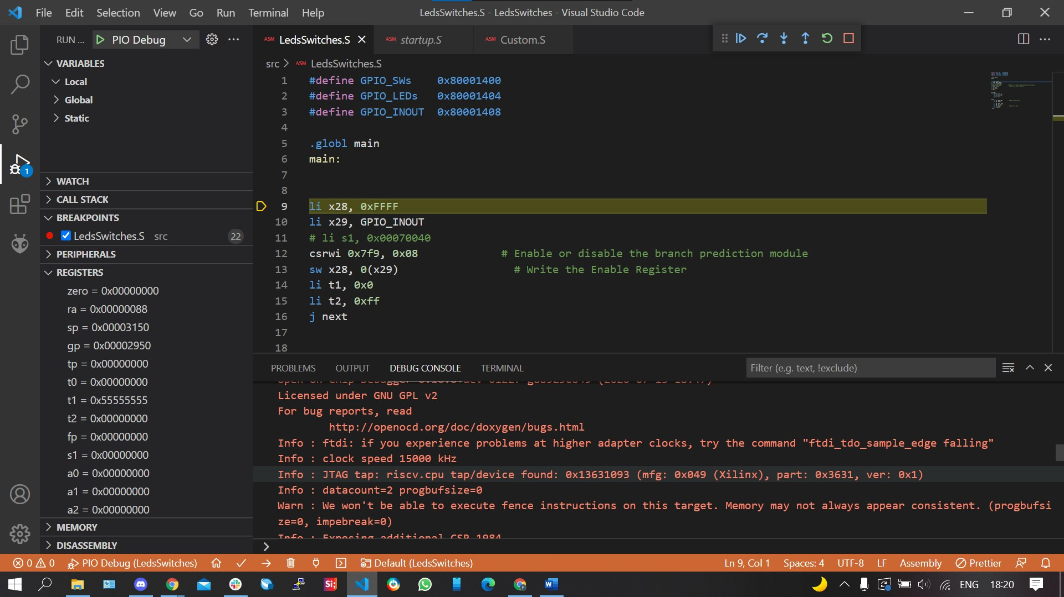

Slide 11
Implementation (Evaluation)
A RISC-V assembly program was written that performed a user defined number of loops over a few arithmetic instructions.
After the loop finished executing the desired amount of times, a breakpoint was reached. From this breakpoint, platformIO’s debug register viewer was used to view the value of “mcycle”.
This value is proportional to the number of cycles executed so it can evaluate performance within the loops.
Branch prediction can be toggled on and off using the SweRV “mfdc” register.
Loop performance could then be compared with and without branch prediction for different numbers of loops

Slide 12
Results
To compare the results, we need to normalize them for any sensible values (average cycle count values range in billions)
With branch prediction on, the results are as expected: less variance and lower cycle counts. This happens because of prediction accuracy improving with increasing branch history table size.
With branch prediction off, the results vary further, with a significant increase in cycle count. However, there is variation in the result for some runs, which indicates that no-branch-prediction schemes can get “lucky” at times.

Slide 13
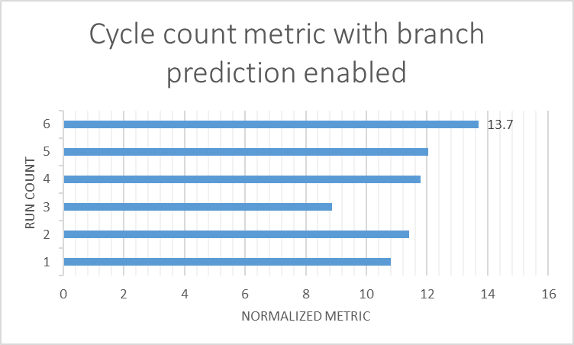
Results of branch prediction enabled

Slide 14
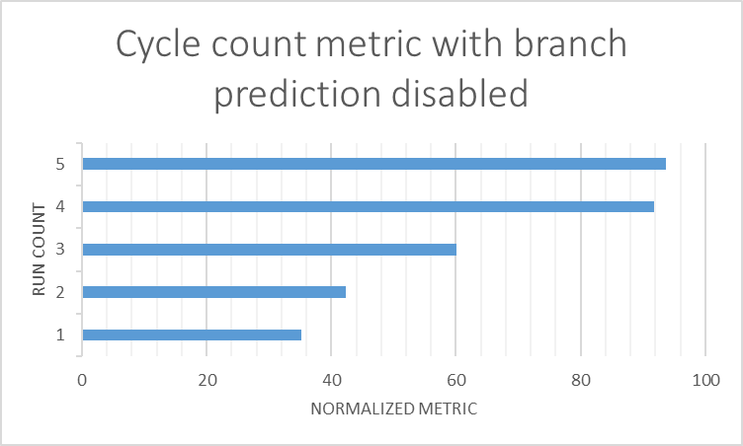
Results of branch prediction disabled

Slide 15
Challenges
VM’s are messy...particularly if they contain many large programs within them.
DRIVERS!
Developing on specific software with few users in your same specific use case (i.e. platformIO chips alliance package).
Extracting branch prediction performance metrics. If their effects are supposed to get flushed before write back, how do we detect mispredictions?
Many more...

Slide 16
Conclusions
With a bit of work and patience, a physical RISC-V processor can be synthesized and implemented in hardware and the RV ISA can be explored through custom assembly programs. Which is pretty cool!
Branch prediction has a profound impact on performance, particularly within programs with a large number of loops.
Market implementations of RISC-V have various different features and expose several status registers for additional data.

Slide 17
References
Matt Godbolt’s blog: BTB in contemporary Intel chips
Western Digital’s documents and specifications of the EH1 core
Imagination University for their RVFPGA program suite
RISC-V specifications

Slide 18
DEMO

